Slide 1
Kinetics Tutorial
Lab 2

Slide 2
Generating standard curve
Abs | 1 | 2 | 3 | 4 | 5 | 6 | 7 | 8 | 9 | 10 | 11
 | 0.0526 | 0.1024 | 0.1435 | 0.1925 | 0.2446 | 0.3040 | 0.3433 | 0.3976 | 0.4355 | 0.5442 | 1.0116
 | 0.0532 | 0.0949 | 0.1654 | 0.1865 | 0.2419 | 0.3037 | 0.3293 | 0.3846 | 0.4321 | 0.5450 | 1.0037
 | 0.0539 | 0.1225 | 0.1635 | 0.1925 | 0.2828 | 0.2971 | 0.3331 | 0.3926 | 0.4433 | 0.5327 | 1.0187
Average each set of triplicates
0.0532 | 0.1066 | 0.1575 | 0.1905 | 0.2564 | 0.3016 | 0.3352 | 0.3916 | 0.4370 | 0.5406 | 1.0113
Subtract blank ([p-NP] = 0) from all other samples
0.0000 | 0.0534 | 0.1043 | 0.1373 | 0.2032 | 0.2484 | 0.2820 | 0.3384 | 0.3838 | 0.4874 | 0.9581
These are the absorbance values you should be plotting for your standard curve

Slide 3
Standard curve
Make sure your units for [pNP] are in moles/L to simplify your next calculation!

Slide 4
Calculation of MOLAR Extinction Coefficient
A = εM * c * l
Your standard curve relates “A” and “c”, whereby Slope = ΔA/Δc
Therefore, Slope = εM * l
So rearrange to solve for εM

Slide 5
Kinetic Runs
CONVERT TIME
TO MINUTES
Average triplicates at
each time point
avg. time [s] | 0 mM | 0 mM | 0 mM | 0.054 mM | 0.054 mM | 0.054 mM | 0.081 mM | 0.081 mM | 0.081 mM | 0.108 mM | 0.108 mM | 0.108 mM | 0.162 mM | 0.162 mM | 0.162 mM | 0.27 mM | 0.27 mM | 0.27 mM | 0.54 mM | 0.54 mM | 0.54 mM
0.00 | 0.0478 | 0.0553 | 0.0738 | 0.1302 | 0.1295 | 0.1531 | 0.1702 | 0.1706 | 0.1948 | 0.2612 | 0.2521 | 0.2776 | 0.3775 | 0.3236 | 0.2149 | 0.3286 | 0.4650 | 0.3426 | 0.4608 | 0.4735 | 0.4327
15.00 | 0.0476 | 0.0554 | 0.0766 | 0.1968 | 0.1834 | 0.2087 | 0.2695 | 0.2781 | 0.3117 | 0.4473 | 0.4143 | 0.4589 | 0.6507 | 0.5558 | 0.4360 | 0.6731 | 0.8608 | 0.7189 | 0.9658 | 0.9893 | 0.9351
30.00 | 0.0473 | 0.0551 | 0.0770 | 0.2449 | 0.2200 | 0.2493 | 0.3456 | 0.3551 | 0.3888 | 0.5831 | 0.5388 | 0.5925 | 0.8487 | 0.7427 | 0.6141 | 0.9856 | 1.1534 | 1.0363 | 1.3778 | 1.4137 | 1.3637
45.00 | 0.0474 | 0.0558 | 0.0772 | 0.2797 | 0.2466 | 0.2786 | 0.4027 | 0.4103 | 0.4461 | 0.6755 | 0.6296 | 0.6890 | 0.9930 | 0.8854 | 0.7595 | 1.2230 | 1.3832 | 1.2524 | 1.7318 | 1.7571 | 1.7135
60.00 | 0.0474 | 0.0555 | 0.0771 | 0.3035 | 0.2661 | 0.3023 | 0.4440 | 0.4511 | 0.4869 | 0.7393 | 0.6940 | 0.7535 | 1.0949 | 0.9858 | 0.8702 | 1.4016 | 1.5519 | 1.4452 | 2.0271 | 2.0505 | 2.0172
75.00 | 0.0475 | 0.0554 | 0.0773 | 0.3209 | 0.2808 | 0.3193 | 0.4747 | 0.4799 | 0.5165 | 0.7811 | 0.7393 | 0.7965 | 1.1632 | 1.0566 | 0.9511 | 1.5511 | 1.6701 | 1.6182 | 2.2624 | 2.2796 | 2.2589
90.00 | 0.0474 | 0.0552 | 0.0772 | 0.3338 | 0.2924 | 0.3325 | 0.4972 | 0.5015 | 0.6005 | 0.8099 | 0.7708 | 0.8249 | 1.2075 | 1.1061 | 1.0115 | 1.6535 | 1.7658 | 1.7302 | 2.4669 | 2.4717 | 2.4680
105.00 | 0.0474 | 0.0558 | 0.0773 | 0.3441 | 0.3024 | 0.3429 | 0.5144 | 0.5194 | 0.5590 | 0.8296 | 0.7931 | 0.8455 | 1.2379 | 1.1420 | 1.0570 | 1.7318 | 1.8284 | 1.8032 | 2.6503 | 2.6412 | 2.6460
120.00 | 0.0474 | 0.0556 | 0.0776 | 0.3522 | 0.3103 | 0.3519 | 0.5277 | 0.5322 | 0.5734 | 0.8425 | 0.8080 | 0.8601 | 1.2551 | 1.1679 | 1.0930 | 1.7884 | 1.8622 | 1.8575 | 2.7916 | 2.7681 | 2.7834
135.00 | 0.0475 | 0.0551 | 0.0770 | 0.3582 | 0.3178 | 0.3573 | 0.5386 | 0.5427 | 0.5852 | 0.8515 | 0.8178 | 0.8695 | 1.2646 | 1.1870 | 1.1195 | 1.8278 | 1.8859 | 1.8950 | 2.9086 | 2.8776 | 2.8980
150.00 | 0.0474 | 0.0556 | 0.0774 | 0.3634 | 0.3239 | 0.3625 | 0.5476 | 0.5515 | 0.5946 | 0.8578 | 0.8250 | 0.8765 | 1.2721 | 1.2031 | 1.1408 | 1.8427 | 1.9033 | 1.9203 | 3.0206 | 2.9718 | 3.0315
165.00 | 0.0475 | 0.0556 | 0.0775 | 0.3678 | 0.3289 | 0.3686 | 0.5553 | 0.5586 | 0.6027 | 0.8603 | 0.8303 | 0.8821 | 1.2773 | 1.2129 | 1.1593 | 1.8473 | 1.9160 | 1.9363 | 3.1077 | 3.0550 | 3.1293
180.00 | 0.0475 | 0.0550 | 0.0772 | 0.3712 | 0.3337 | 0.3740 | 0.5616 | 0.5642 | 0.6091 | 0.8627 | 0.8333 | 0.8858 | 1.2796 | 1.2215 | 1.1732 | 1.8481 | 1.9272 | 1.9452 | 3.1768 | 3.1129 | 3.1820

Slide 6
Absorbance profiles
Data collected from reactions using 1.42nM AP

Slide 7
Absorbance profiles
Data collected from reactions using 1.42nM AP
Calculate the slope of the LINEAR portion of each [pNPP] plotted

Slide 8
Calculation of V_{o} values
V_{o}(M/min)= (Slope (Abs/min)) / (εM x l)
As you may recall,
(εM x l) = Slope of standard curve
Therefore,
V_{o}(M/min) = SlopeA405vsTime(Abs/min)/Slopestdcurve(Abs/M)
Convert units of Vo to μM/min before continuing on with graphical analysis
M = mol/L
µM = µmol/L

Slide 9
Graphical Analysis
Convert effective [pNPP] (Table 1.2 final column) to μM
Now you have [S] in μM and V_{o} in µM/min
It is important that your units match before you being graphical analysis!

Slide 10
Graphical Analysis
DO NOT INCLUDE Vo for [pNPP] = 0 FOR ANY GRAPHICAL ANALYSIS FROM THIS POINT ONWARDS

Slide 11
Michaelis-Menten plot
K_{M} = 639.7 µM
Vmax = 436.6 µM/min

Slide 12
Michaelis-Menten plot
Enzyme has not been saturated
Enzyme has been saturated
When the enzyme has not been saturated, the calculated K_{M} and Vmax are less accurate.

Slide 13
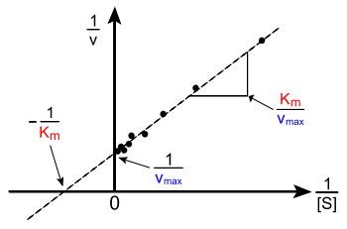
Lineweaver-Burke Plot
To plot this graph you must first calculate 1/V_{o} and 1/[S] from values in Question 6
Notes:
With regards to the Lineweaver Burke plot I noticed on the Michaelis Menten plot that the lowest two concentrations don’t really fit the line. Of course with Lineweaver Burke these two points are now way on the right, which skews the trendline fit. If you delete those two points the trendline crosses at +y and -x. I think because the lower concentrations tend to be the least accurate, then in Lineweaver Burke because it’s 1/[S], that error is amplified and that’s why their plots are wrong. Maybe some people will have better data for the lower concentrations this time.

Slide 14
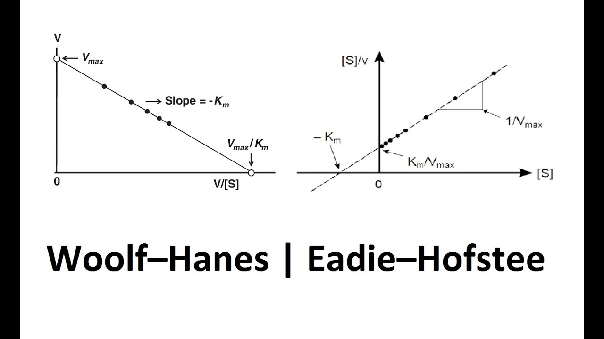
Eadie-Hofstee and Hanes Plots

